Slide 1
Data Visualization 2
Introduction to Data Visualization with Python
2023 Fall - Session 2

Slide 2
Housekeeping
Please be informed that the lectures of the Data Visualization 3 course will be streamed and recorded by the Department of Economics and Business and shared via Moodle where you and all other participants of the course can watch it until the end of the Spring semester. After that date the recording will be deleted. During the recording your image or voice might be recorded. The Department of Economics and Business publishes the recording of the lecture with no modifications.

Slide 3
Housekeeping
Please be informed that the lectures of the Data Visualization 2 course will be recorded by the Department of Economics and Business and shared via Moodle where you and all other participants of the course can watch it until the end of the semester. After that date the recording will be deleted. During the recording your image or voice might be recorded. The Department of Economics and Business publishes the recording of the lecture with no modifications.

Slide 4
Agenda
Today’s agenda
Plotly Express Review
Intro to Dash
Dash Hands-on
Personal project discussion
Please fill in the Course Evaluation form!

Slide 5
Ploty Express

Slide 6
Ploty Express Review

Slide 7
Plotly Express
Plotly Express (PX) is a high-level, declarative dataviz library
It creates complete charts with a single Python call
Support many different chart types
The syntax aims to be very dense, just the bare mininum
Has smart defauls for most chart aspects
Also provides more detailed setting, if needed
The PX package provides:
Create functions for each supported chart type (px.bar, px.line, …)
Built-in demo datasets (px.data.*)
Built-in color color scales and sequences (px.color.*)

Slide 8
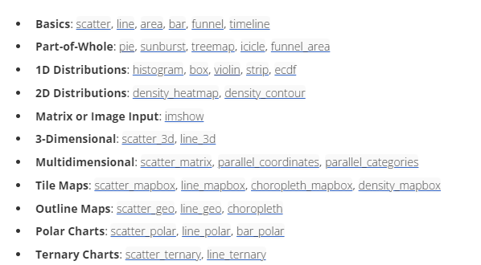
Plotly Express – Charts
Chart types in Plotly Express

Slide 9
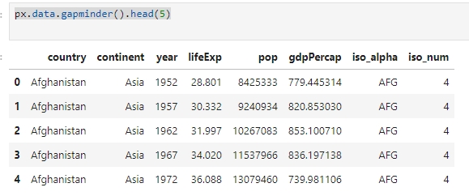
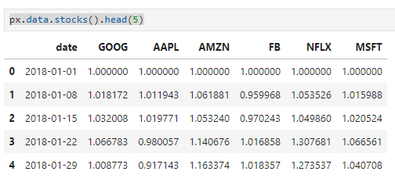
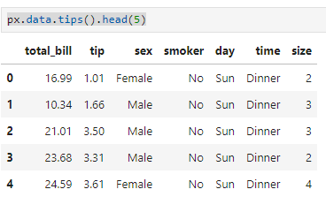
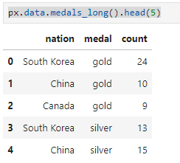
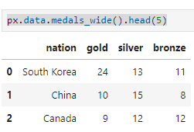
Plotly Express - Datasets
A few built-in dataset in PX

Slide 10
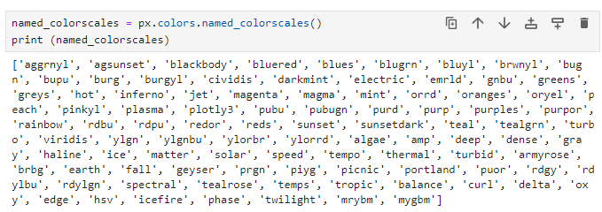
Plotly Express - Datasets
Built-in color scales

Slide 11
Plotly Express syntax
Minimal syntax for quick chart creation
Gapminder examples
df_us = px.data.gapminder().query('country == "United States„’)
px.bar(df_us, x = 'year', y = 'pop’)
px.line(df_us, x = 'year', y = 'pop’)
px.area(df_us, x = 'year', y = 'pop’)
Tips examples
df_tips = px.data.tips()
px.bar(df_tips, x="total_bill", y="day")
px.strip(df_tips, x="total_bill", y="day")
px.pie(df_tips, values='total_bill', names='day')

Slide 12
Plotly Express customization
Many attributes can be changes
Background color
Chart size
Title text and formatting
Axis titles, labels, type, formatting
Data labels, position,formatting
….

Slide 13
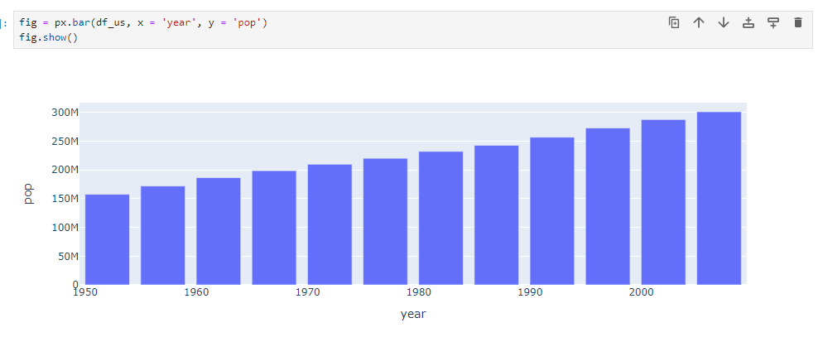
Plotly Express customization
The minimal base chart

Slide 14
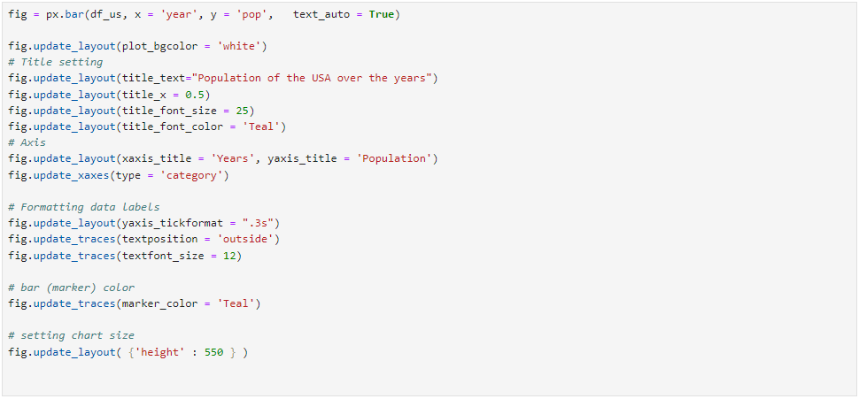
Plotly Express customization
A few customization

Slide 15
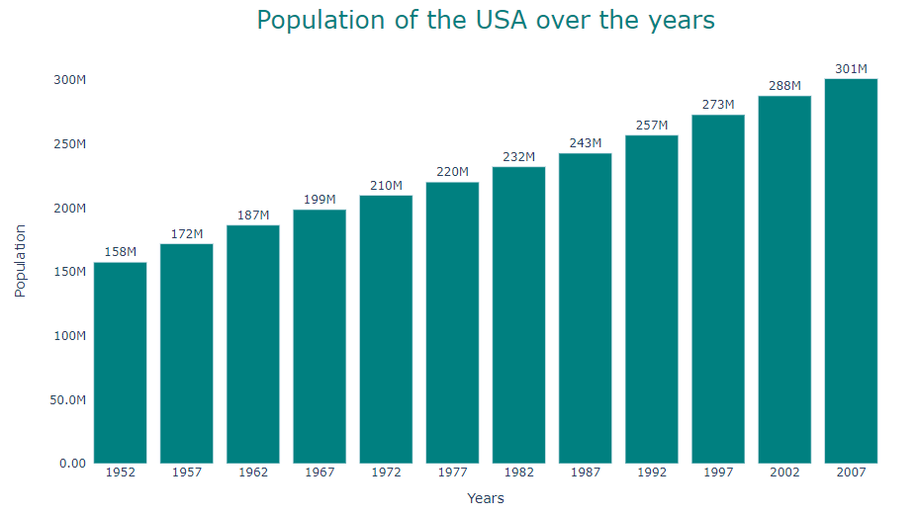
Plotly Express customization
A few customization

Slide 16
Ploty Express hands-on

Slide 17
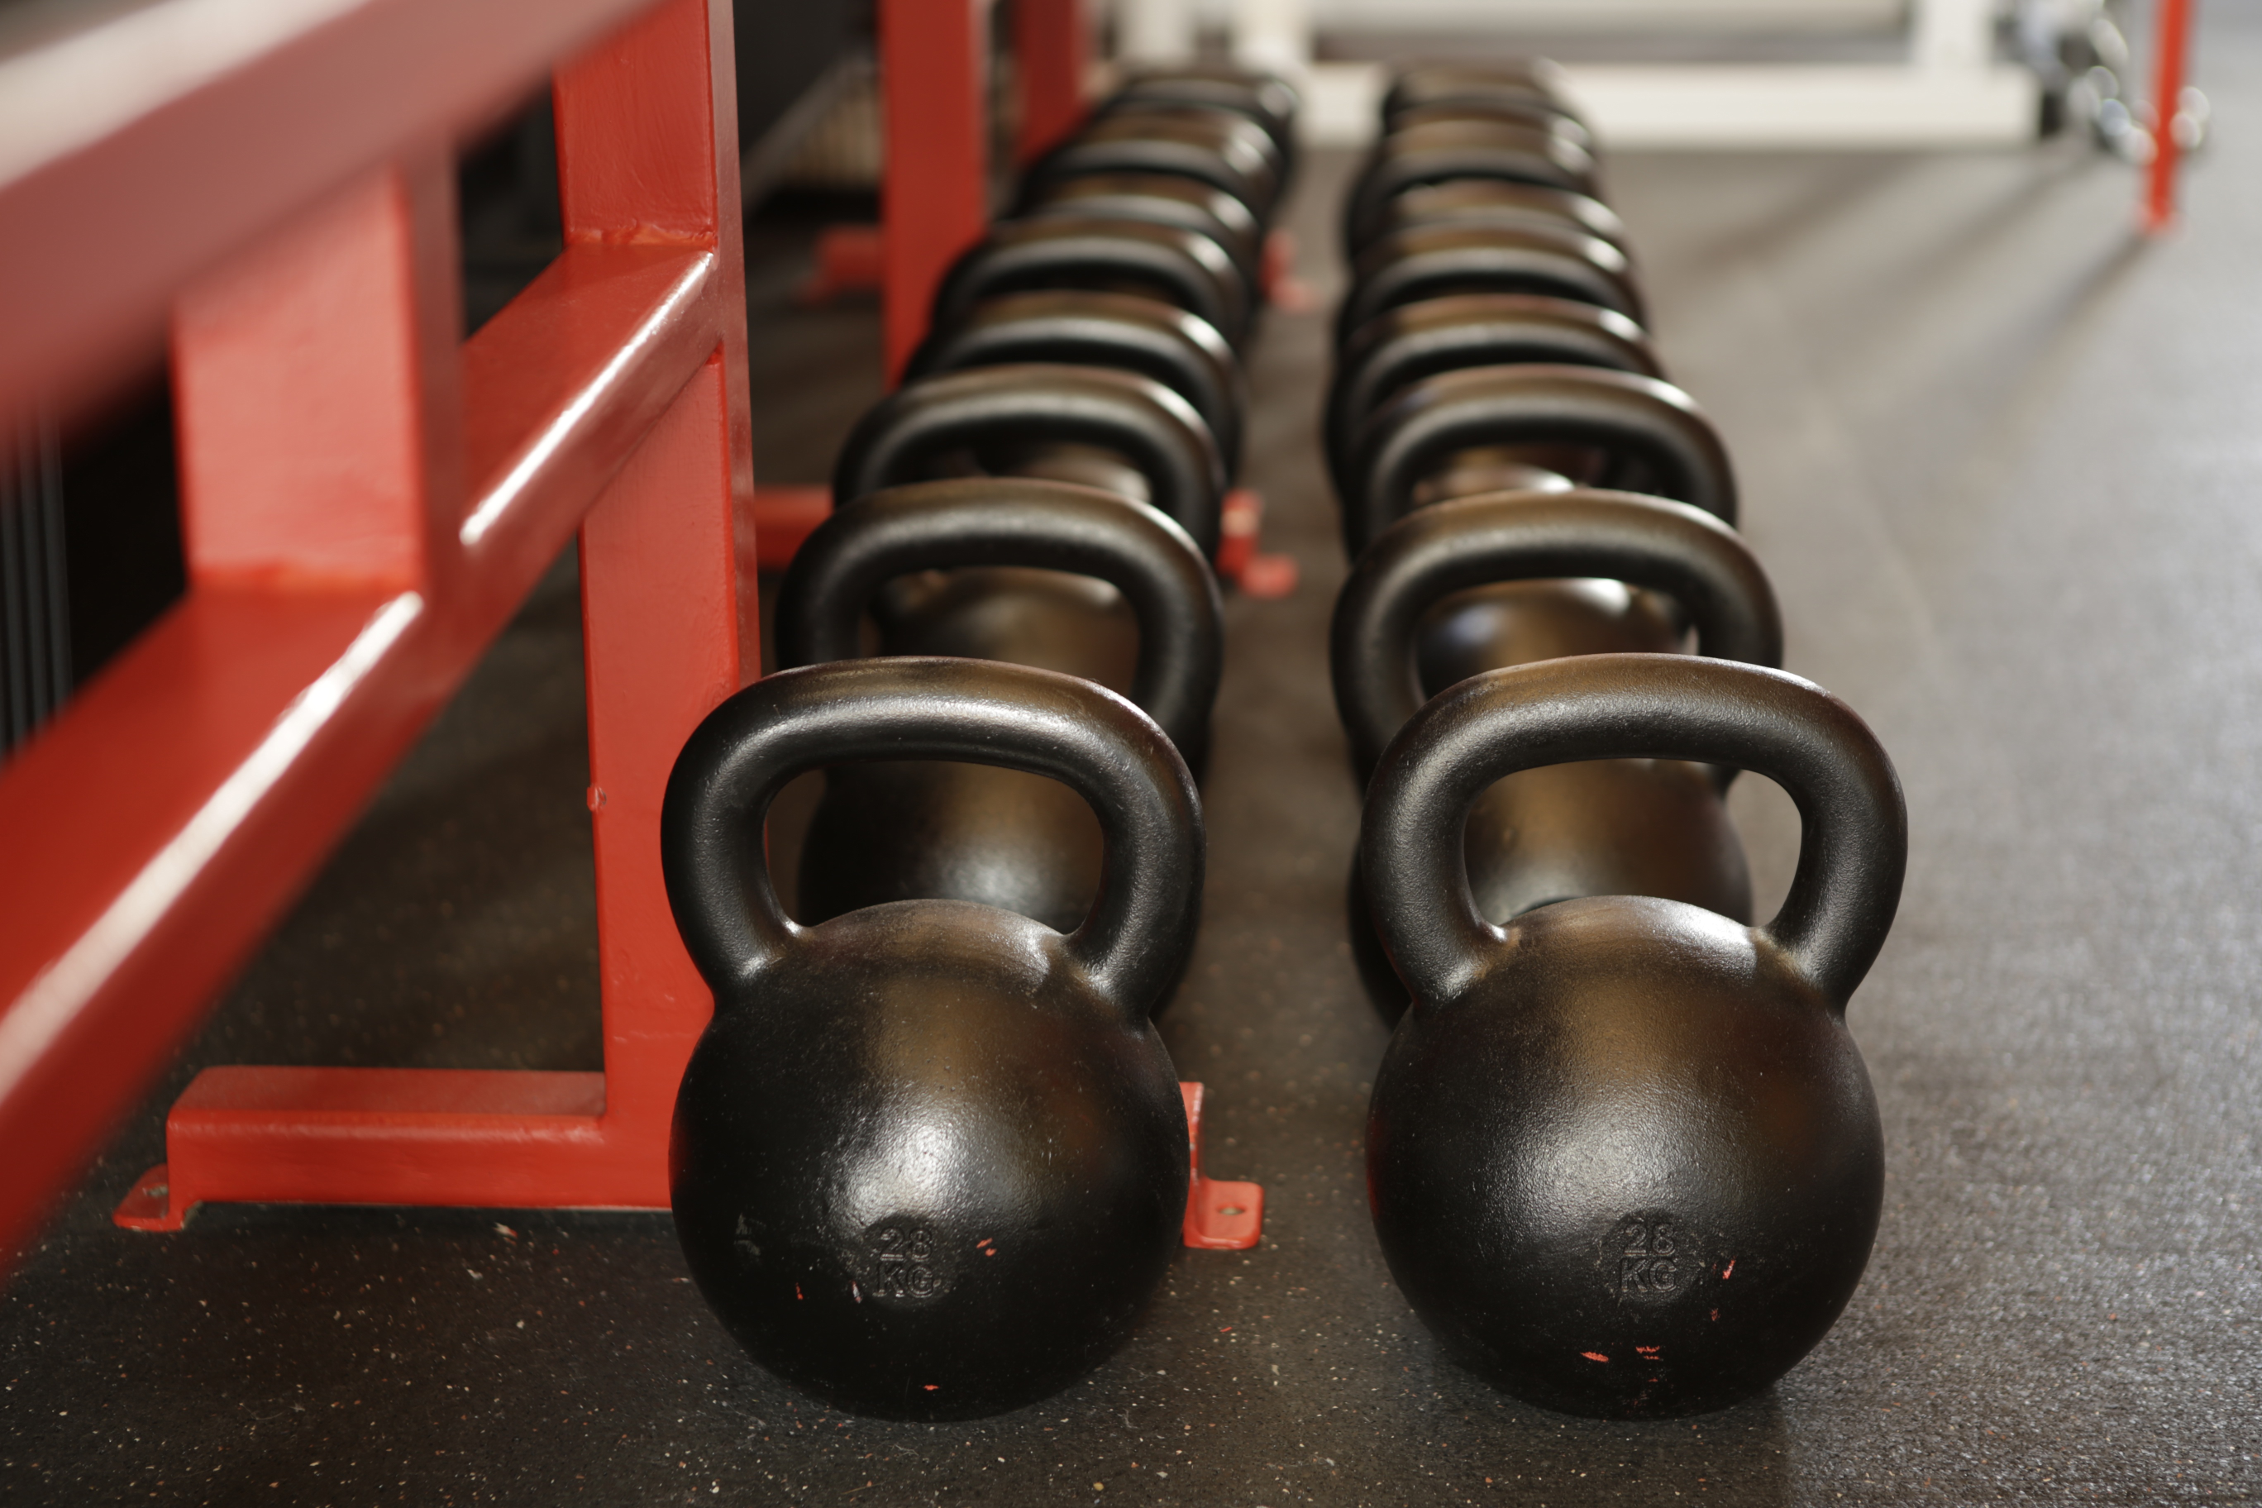
Plotly Express hands-on

Slide 18
Plotly Dash

Slide 19
Dataviz in Python
Python has many data visualization tools
Maybe too many ☺
You can think of the main categories as
Classic or „old school” dataviz tools (e.g matplotlib)
Modern dataviz libraries (plotly, altair, holoviz)
Special libraries for people already familiar with dataviz in other languages / frameworks (e.g plotnine for R/ggplot2 users)
There are 3 layers
Low-level charting libraries – main goal is functionality
High-level charting libraries – main goal is ease of use
Dashboarding libraries – assembling charts into interactive apps

Slide 20
Background
Charting libraries
Dashboards & Analytic apps
Ggplot2 (R)
plotnine
Voilà
MATLAB
Matplotlib
Seaborn
Panel
Holoviews
hvPlot
Plotly Dash
Bokeh
Chartify
Pandas-Bokeh
Streamlit
Web / Javascript
Plotly Graph Objects
Plotly Express
Shiny for Python
Vega & Vega-lite
Altair
@bencearato

Slide 21
Plotly Dash
Dash is an open source framework for building visual apps and dashboards in Python
It comes from the same company as Plotly Express, so working with PX charts is quite easy
There’s a free open source version and a paid Enterprise version which has extra features
Dash can be run standalone, installed on your local machine or within Google Colab

Slide 22
Simple app layouts

Slide 23
Plotly Dash
A Dash app has 2 main parts, Layout and Callbacks
Layout goals
For defining the app components - text, chart, tables etc.
Customizing the appearance (size, colors, alignment etc.)
Layout elements
A mix of HTML, CSS
Custom components (charts, slicer etc).

Slide 24
Dash HTML components
Dash has a built-in library of common HTML components
DIV
P
H1, H2
These will be rendered as standard HTML code when the app is running
HTML.H1('my text’) -> <h1>my text </h1>
The components also can be styled using the standard HTML and CSS way, if needed
https://dash.plotly.com/dash-html-components

Slide 25
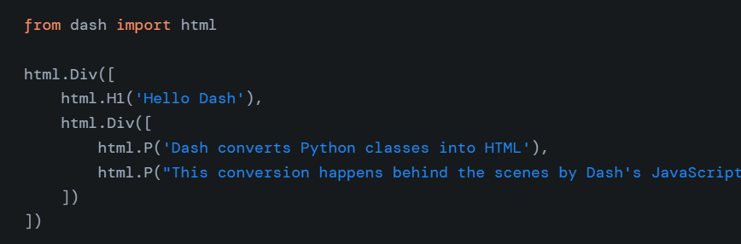
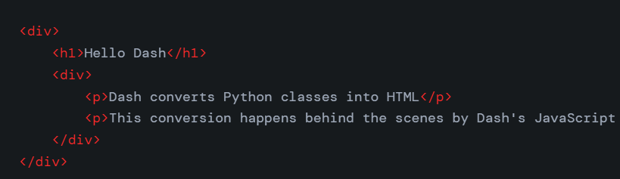
HTML components

Slide 26
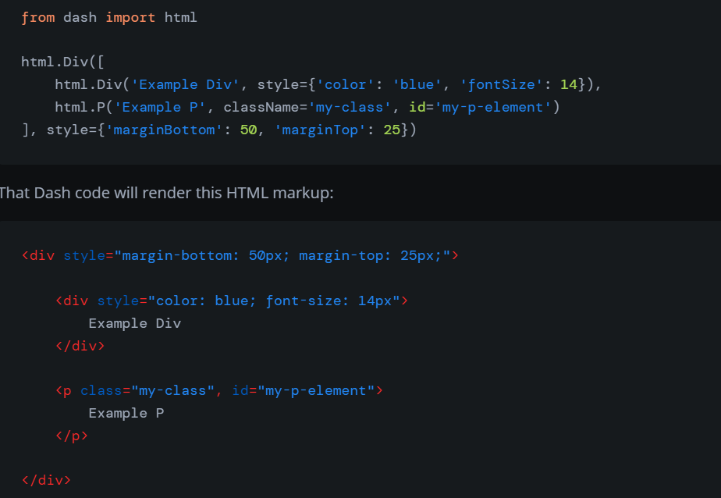
HTML components with CSS formatting

Slide 27
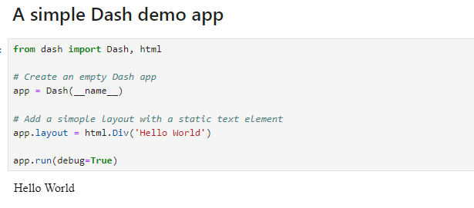
Simple Dash Apps

Slide 28
Dash Core Components
Dash also has support for components commonly used in web apps
A few examples
dcc.Graph – for PX charts
dcc.Input - text input
dcc.RadioItems, dcc.Dropdown – Filters/slicers
https://dash.plotly.com/dash-core-components

Slide 29
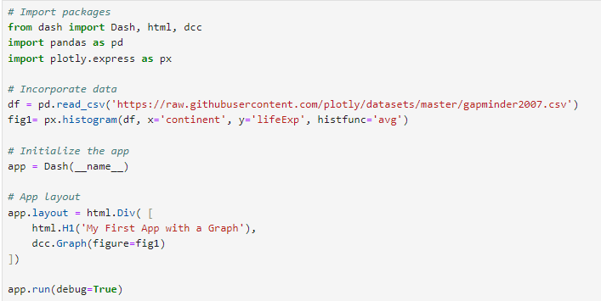
Dash App with a graph

Slide 30
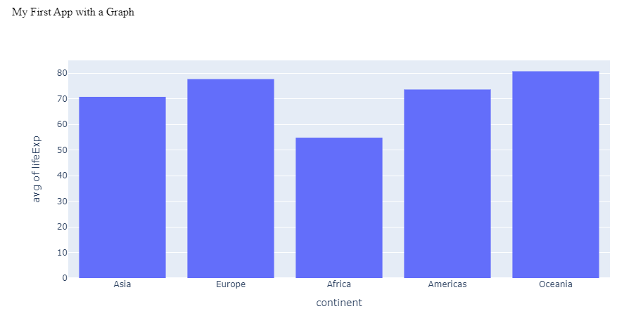
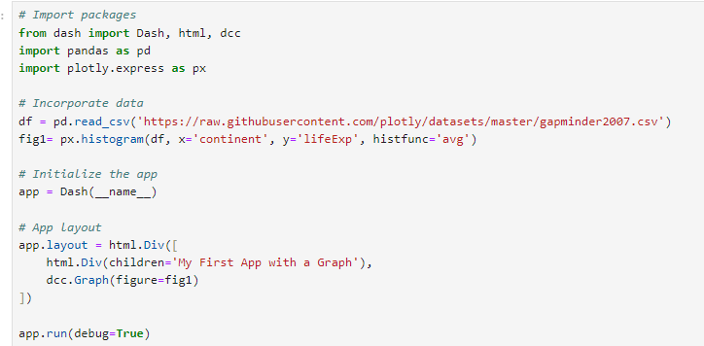
Dash App with a graph

Slide 31
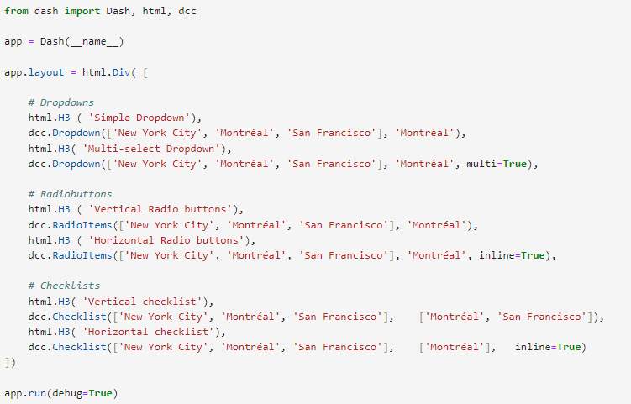
Dash input controls

Slide 32
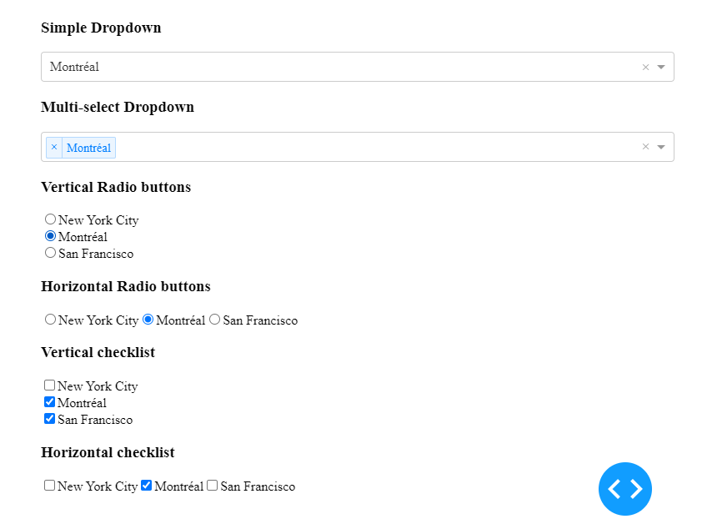
Dash input controls

Slide 33
Plotly Dash
Dash core components (examples)
dcc.Graph
dcc.Input, dcc.RadioItems, dcc.Dropdown
….
https://dash.plotly.com/dash-core-components
Dash HTML components (examples)
html.H1, html.H2,…
html.Div
….
https://dash.plotly.com/dash-html-components

Slide 34
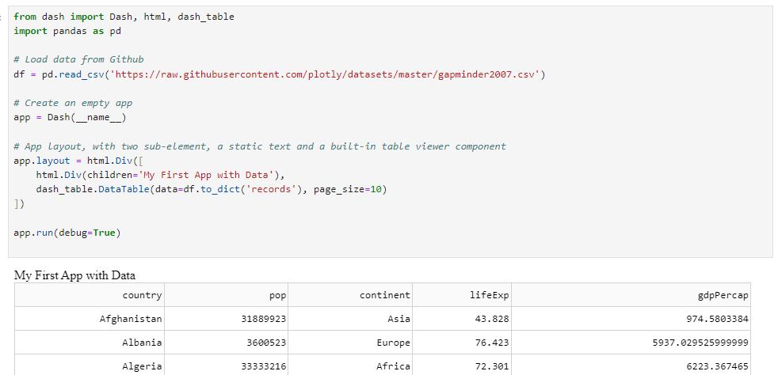
Simple Dash Apps

Slide 35
Simple Dash Apps

Slide 36
Interactivity

Slide 37
Interactivity in Dash
A Dash app has 2 main parts, Layout and Callbacks
Callbacks goals
For setting up the interaction between the app components
We define WHAT happens WHEN:
If the user changes the COUNTRY DROPDOWN then FILTER the data accordingly in CHART 1
Callbacks have 2 sub-components
Callback definition: what are the inputs and the outputs
Callback processing: the code to run when the input changes

Slide 38
Interactivity in Dash
A simple example is updating a chart based on user input
The App layout will consist of a chart and an input text box
When the user types something into the input box the chart title will be updated to show the new text

Slide 39
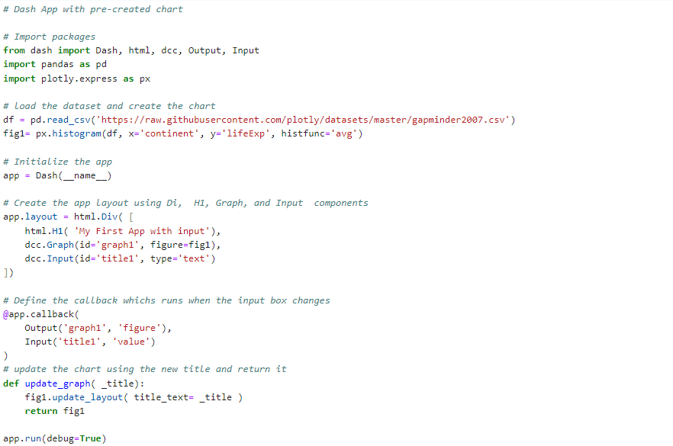
Interactivity in Dash

Slide 40
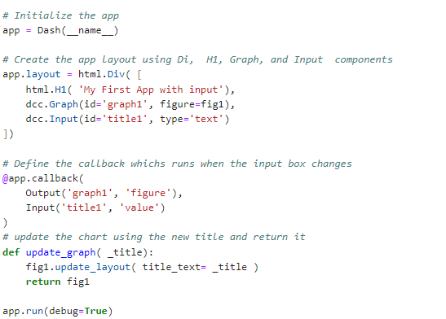
Interactivity in Dash
Callback definition
Callback processing

Slide 41
Interactivity in Dash
For more advanced processing we can define the whole chart in the callback
It’s useful when we want to change something which can be only done when we create a chart
Examples
Change the dataframe used by the chart
Change wich data column(s) assigned to x or y label

Slide 42
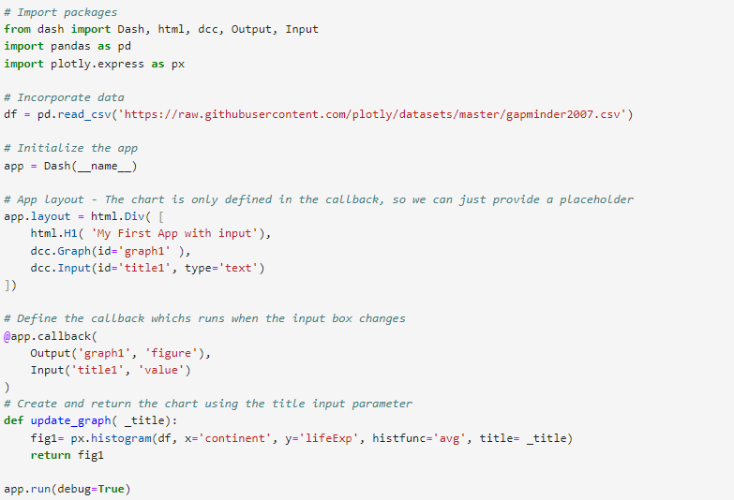
Using inputs in Dash

Slide 43
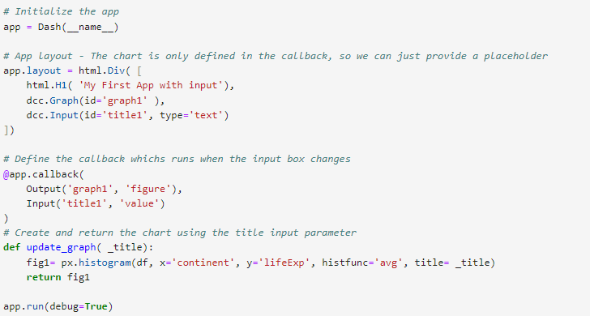
Using inputs in Dash
Defining the chart only in the callback

Slide 44
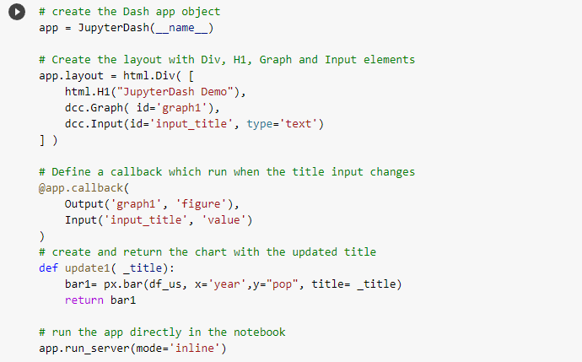
Plotly Dash

Slide 45
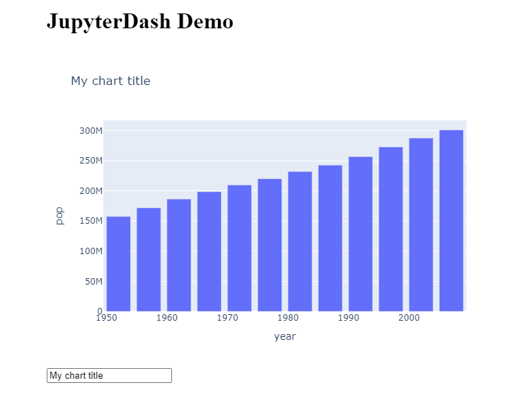
Plotly Dash

Slide 46
Dash hands-on

Slide 47
Dash hands-on

Slide 48
Thank You

